Slide 1
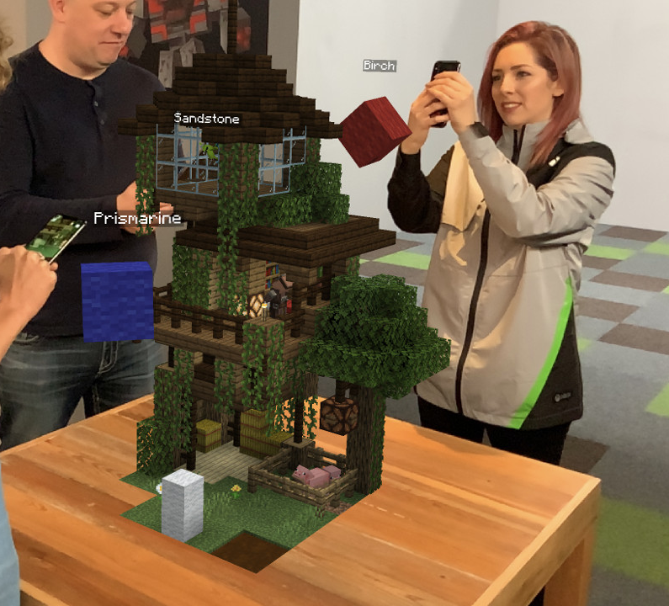
WEEK 3
AGGP 231C
Application Development and Software Prototyping

Slide 2
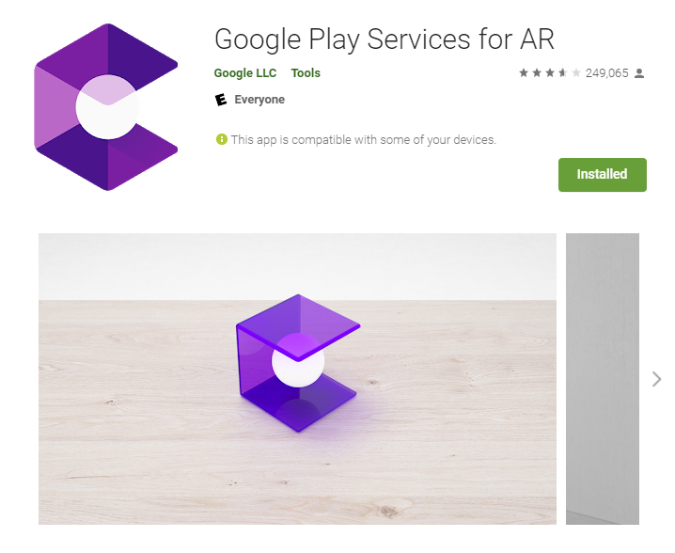

Google Play Services for AR
“Installs Automatically…”
Double-check to make sure
Notes:
AR Foundation allows you to work with augmented reality platforms in a multi-platform way within Unity. This package presents an interface for Unity developers to use, but doesn't implement any AR features itself. To use AR Foundation on a target device, you also need separate packages for the target platforms officially supported by Unity

Slide 3


AR Foundation – What is it?
Unity Package
Recognition and Tracking Technology
Supports
ARCore XR Plugin (Android)
ARKit XR Plugin (iOS)
Magic Leap XR Plugin (Magic Leap)
Windows XR Plugin (HoloLens)
Notes:
AR Foundation allows you to work with augmented reality platforms in a multi-platform way within Unity. This package presents an interface for Unity developers to use, but doesn't implement any AR features itself. To use AR Foundation on a target device, you also need separate packages for the target platforms officially supported by Unity

Slide 4
AR Foundation – Supported Concepts
Device Tracking
Plane Detection
Point Clouds
Anchor
Light Estimation
Environment Probe
Face Tracking
2D Image Tracking
3D Object Tracking
Meshing
Body Tracking
Collaborative Participants
Human Segmentation and Occlusion
Raycast
Pass-through Video
Session Management
Occlusion
Notes:
Device tracking: track the device's position and orientation in physical space.
Plane detection: detect horizontal and vertical surfaces.
Point clouds, also known as feature points.
Anchor: an arbitrary position and orientation that the device tracks.
Light estimation: estimates for average color temperature and brightness in physical space.
Environment probe: a means for generating a cube map to represent a particular area of the physical environment.
Face tracking: detect and track human faces.
2D image tracking: detect and track 2D images.
3D object tracking: detect 3D objects.
Meshing: generate triangle meshes that correspond to the physical space.
Body tracking: 2D and 3D representations of humans recognized in physical space.
Colaborative participants: track the position and orientation of other devices in a shared AR experience.
Human segmentation and occlusion: apply distance to objects in the physical world to rendered 3D content, which achieves a realistic blending of physical and virtual objects.
Raycast: queries physical surroundings for detected planes and feature points.
Pass-through video: optimized rendering of mobile camera image onto touch screen as the background for AR content.
Session management: manipulation of the platform-level configuration automatically when AR Features are enable or disabled.
Occlusion:

Slide 5
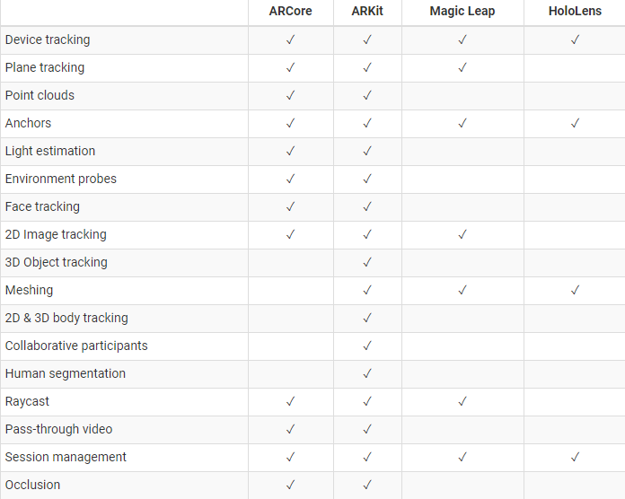

Slide 6
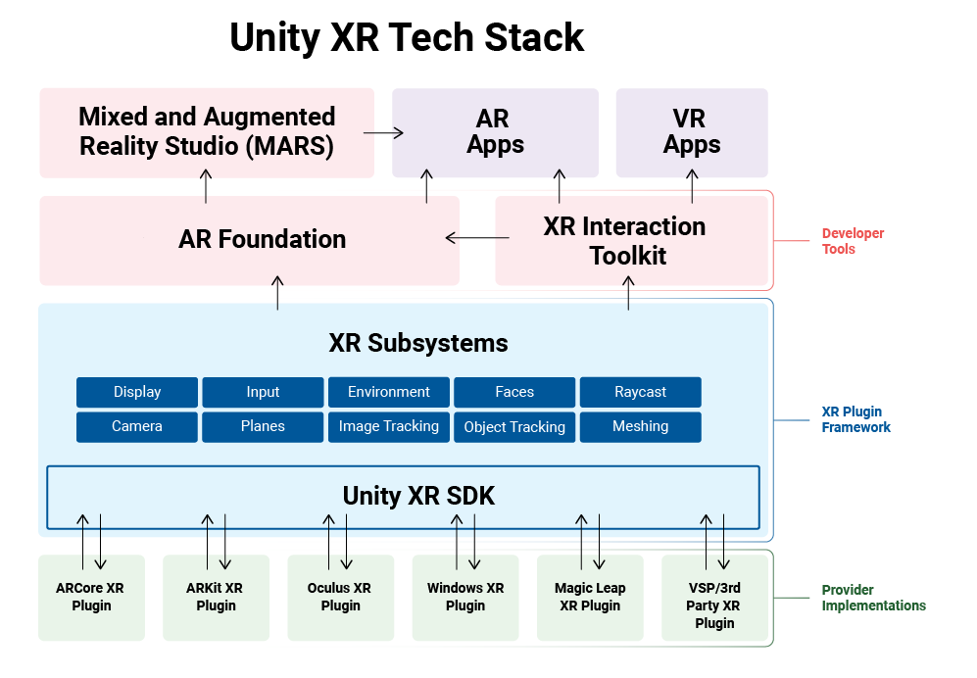

Slide 7
AR Foundation – Glossary
Tracking
The AR device's ability to determine its relative position and orientation in the physical world. If the environment is too dark, for example, the device might "lose tracking", which means it can no longer accurately report its position.
Trackable
A real-world feature, such as a planar surface, that the AR device tracks and/or detects.
Feature Point
A specific point in a point cloud. An AR device uses the device’s camera and image analysis to track specific points in the world, and uses these points to build a map of its environment. These are usually high-frequency elements, such as a knot in a wood-grain surface.
Session
An AR instance.
Session Space
The coordinate system relative to the beginning of the AR session. For example, session space (0, 0, 0) refers to the position at which the AR session was created. An AR device typically reports trackables and tracking information relative to its session origin.

Slide 8

ARCore – How does it work?
Motion Tracking
Environmental Understanding
Light Estimation
COM: Concurrent Odometry and Mapping
Notes:
It tracks the position of your phone in the real world, and it builds an understanding of your surroundings by identifying walls and floors in the environment.
ARCore looks at a camera image and detects visually distinct features, called feature points. Then it uses these points to figure out its change in position. The visual information is combined with inertial measurements from the device to estimate the pose (position and orientation) of the camera relative to the world over time.
By aligning the pose of the virtual camera that renders 3D content with the pose of the device's camera, ARCore renders virtual content from the correct perspective. That virtual image is overlaid on top of a live camera image, making the virtual content appear as part of the real world.

Slide 9
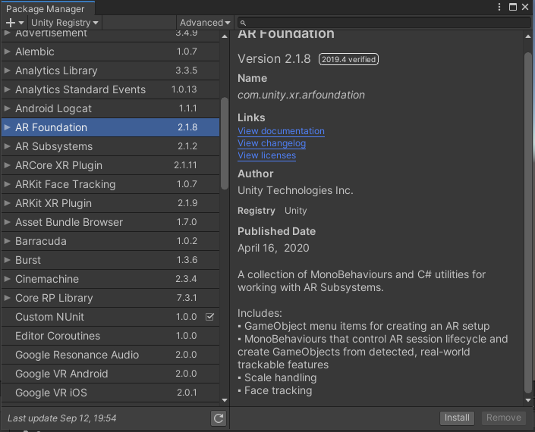
AR Foundation – Step 1
Create a new Unity Project (2019.4.9f1)
Build Settings… > Switch Platform to Android
Install AR Foundation Package
Window > Package Manager > AR Foundation
This will also install AR Subsystems for you

Slide 10
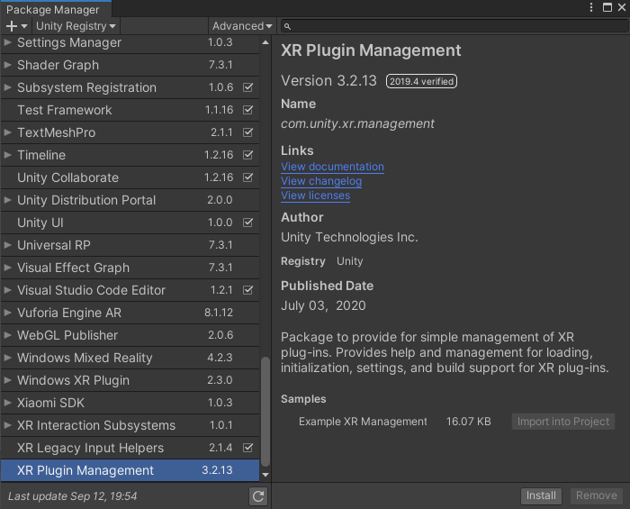
AR Foundation – Step 2
Install XR Plugin Management Package
Window > Package Manager > XR Plugin Management

Slide 11
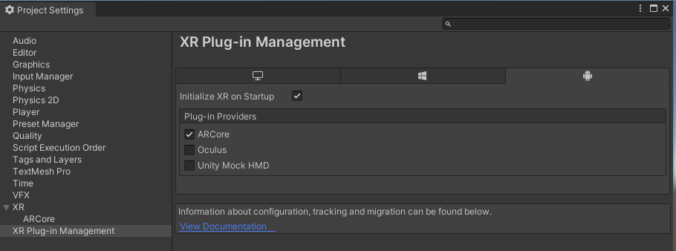
AR Foundation – Step 3
Set XR Plug-in Management to ARCore
Edit > Project Settings > XR Plug-in Management
This will install the ARCore XR Plugin Package for you

Slide 12
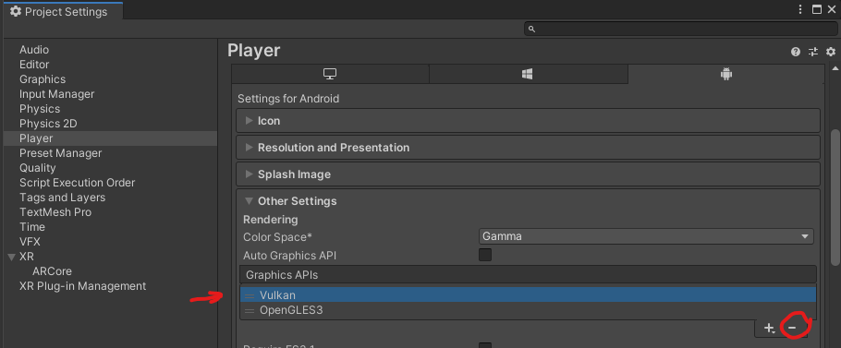
AR Foundation – Step 4
Remove Vulkan Graphic API
File > Build Settings… > Player Settings > Other Settings section

Slide 13
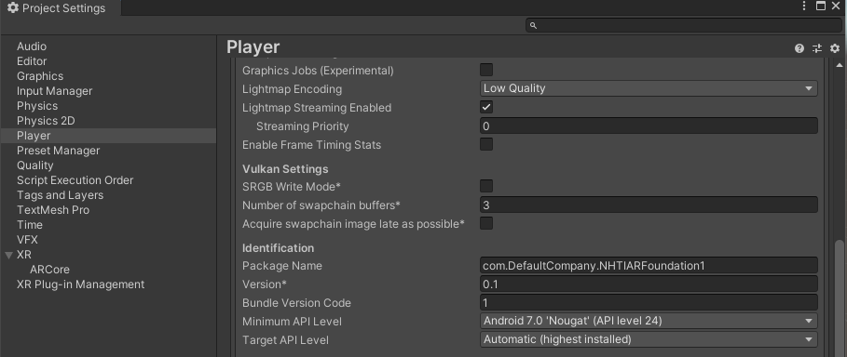
AR Foundation – Step 5
Set Android Minimum API Level to 24
File > Build Settings… > Player Settings > Other Settings section

Slide 14
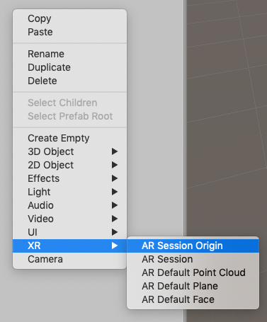
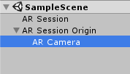
AR Foundation – Scene Setup
Basic AR Scene Hierarchy
AR Session
AR Session Origin
Note: AR Camera comes with AR Session Origin
*Don’t forget to add EventSystem and a Directional Light

Slide 15
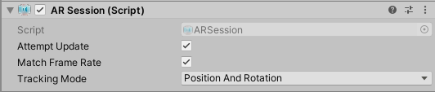
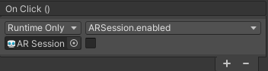
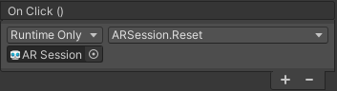
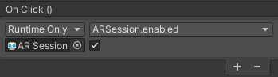
AR Foundation - AR Session
Controls the lifecycle of an AR experience by enabling or disabling AR on the target platform
PAUSE
RESET
RESUME
*AR sessions are CPU intensive and can make the device run hot!
Notes:
When you disable the ARSession, the system no longer tracks features in its environment, but if you enable it at a later time, the system will attempt to recover and maintain previously-detected features.
If you enable the Attempt Update option, the device tries to install AR software if possible. Support for this feature is platform-dependent.

Slide 16
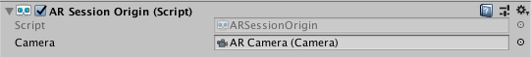


AR Foundation - AR Session Origin
Transforms trackable features into their final Pose in the Unity Scene
Scale
Transform
Bigger scale = smaller content
Notes:
The purpose of the ARSessionOrigin is to transform trackable features, such as planar surfaces and feature points, into their final position, orientation, and scale in the Unity Scene. Because AR devices provide their data in "session space", which is an unscaled space relative to the beginning of the AR session, the ARSessionOrigin performs the appropriate transformation into Unity space.
This concept is similar to the difference between "model" or "local" space and world space when working with other Assets in Unity. For instance, if you import a house Asset from a DCC tool, the door's position is relative to the modeler's origin. This is commonly called "model space" or "local space". When Unity instantiates it, it also has a world space that's relative to Unity's origin.
Likewise, trackables that an AR device produces, such as planes, are provided in "session space", relative to the device's coordinate system. When instantiated in Unity as GameObjects, they also have a world space. In order to instantiate them in the correct place, AR Foundation needs to know where the session origin should be in the Unity scene.
ARSessionOrigin also allows you to scale virtual content and apply an offset to the AR Camera. If you're scaling or offsetting the ARSessionOrigin, then its AR Camera should be a child of the ARSessionOrigin. Because the AR Camera is session-driven, this setup allows the AR Camera and detected trackables to move together.

Slide 17
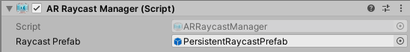
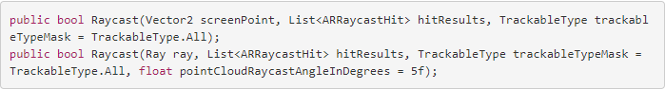
AR Foundation – AR Raycast Manager
Only hit tests against trackable planes and points in the point cloud.
Add this component to the same GameObject as the AR Session Origin
There are two ray casting methods on the AR Raycast Manager
ScreenPoint
Arbitrary Ray
You can pass a touch position directly

Slide 18
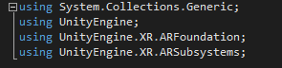
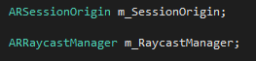
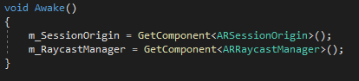
AR Foundation – MakeAppearOnPlane
Move the ARSessionOrigin in such a way that it makes the given content appear to be at a given location acquired via a raycast.
Add an empty GameObject to the Scene named “Content”
Add the Robot Kyle asset to the Content GameObject
Create a C# Script, name it “MakeAppearOnPlane”
Add ARRaycastManager to ARSessionOrigin
Attach the MakeAppearOnPlane script to ARSessionOrigin
What do we want MakeAppearOnPlane to do?
Take a Transform and make it appear at a Touch Point
Make the Astronaut appear as tall as you are
*Robot Kyle is a free asset on the Asset Store, download him for this lesson

Slide 19
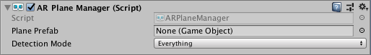
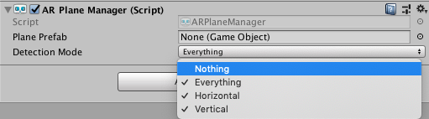
AR Foundation – AR Plane Manager
ARPlaneManager creates GameObjects for each detected plane in the environment.
Add ARPlaneManager to ARSessionOrigin
Make sure ARPlaneManager is referencing the Checkered Plane prefab
Make sure the Checkered Plane prefab is referencing the Checkered material in it’s Mesh Element 0 field
Set ARPlaneManager to detect only Horizontal
*Vertical tracking can have an extra strain on hardware

